Slide 1
Switching and Routing Essentials
CT133-3-2-SRE
Introduction and Overview

Slide 2
Lecturer information
Lecturer Name: Noris Binti Ismail
Email: noris.ismail@staffemail.apu.edu.my
Telephone Extension: 5686

Slide 3
Pre-requisites for this module
CT043-3-1 Introduction to Networking or equivalent

Slide 4
Aims of this module
Contribute to the achievement of the Learning Outcomes specified for the student’s award at Level 2
Enable students to develop their knowledge and skills in relation to switching technologies and router operations that support small-to-medium business networks and includes wireless local area networks (WLANs) and security concepts.
Enables students to learn key switching and routing concepts. Students can perform basic network configuration and troubleshooting, identify and mitigate LAN security threats, and configure and secure a basic WLAN.
Develop the ability of students to apply the knowledge they gain in relation to the study of switching technologies, wireless network and router operations.
Further develop lifelong learning skills of independent learning and study in relation to switching technologies, wireless network and router operations
Enable students to develop their ability to:
Communicate in varied situations
Use ICT relevant to given situations
Be aware of the needs of others and self

Slide 5
Course Learning outcomes, CLOs
At the end of this course, YOU should be able to:
Explain the concepts, architecture, components, and operations of routers and switches in small networks including configuration techniques (C2,PLO1)
Apply dynamic addressing, first-hop redundancy protocols and static routing in IPv4 and IPv6 network (C3,PLO2)
Propose WLAN concepts and configuration using WLC and Layer 2 security best practices (A3, PLO9)
Demonstrate the strategies to implement switch security to mitigate LAN attacks using appropriate tools (A3, PLO6)

Slide 6
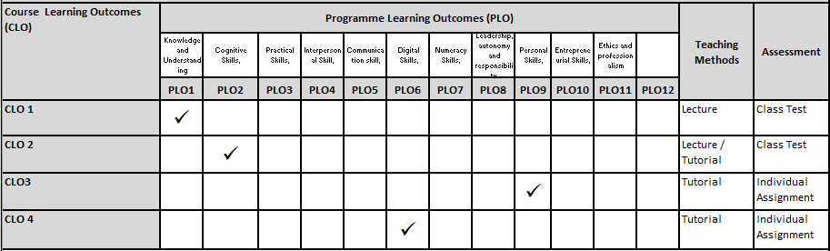
Mapping of CLOs with MOEs Domain
PLO1 – Knowledge and Understanding
PLO2 – Cognitive Skills
PLO6 – Digital Skills
PLO9 – Personal Skills

Slide 7
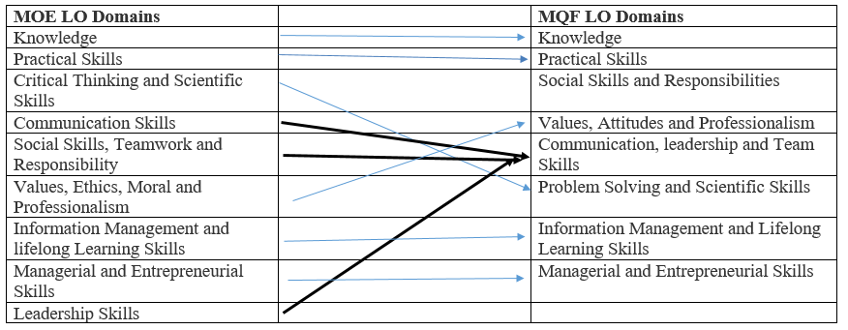
MQF and MOE Domains

Slide 8
Teaching Strategies
Lecture
Lab/Tutorial

Slide 9
Assessment Methods
Class Test 1 (30%) – taken from SRWE final exam in Netacad: CLO1
Class Test 2 (30%) – Packet Tracer test question (on CLO2 topics only)
Individual Assignment (40%) – Wireless Essentials and Security part only (CLO3 and CLO4)
**refer to SAIS for details

Slide 10
Student Learning Time (SLT)
Course Credit Value: 3
Total Learning Hours:
Lecture: 20 hours per semester
Tutorial / Case Study : 22 hours per semester
Independent Learning Time: 66 hours

Slide 11
Methods of Delivery
Hence,
We are now moving from the traditional topic based teaching to outcome-based education

Slide 12
Outcomes Based Education (OBE)
OBE is education based on producing particular educational outcomes that:
Focus on what students can actually do after they are taught
Expect all learners / students to successfully achieve particular (sometimes minimum) level of knowledge and abilities.

Slide 13
So…What is OBE?
It’s
NOT
What we want to teach,
It’s
What You should learn

Slide 14
Course Content Outline
CLO1 : Class Test I (40%)
Explain the concepts, architecture, components, and operations of routers and switches in small networks including configuration techniques
Taken from SRWE final exam in Netacad
Lecture
Switching Concepts
VLAN – InterVLAN, InterVLAN Routing
Routing Concepts
STP
EtherChannel

Slide 15
Course Content Outline
CLO2 : Class Test II (40%)
Apply dynamic addressing, first-hop redundancy protocols and static routing in IPv4 and IPv6 network
Packet Tracer test question (on CLO2 topics only)
Lecture
DHCPV4, SLAAC, DHCPV6 and FHRP
IPV4 and IPV6 Static Routing and Default Route

Slide 16
Course Content Outline
CLO2 & CLO3 : Individual Assignment (40%)
Propose WLAN concepts and configuration using WLC and Layer 2 security best practices.
Demonstrate the strategies to implement switch security to mitigate LAN attacks using appropriate tools.
Case Study
Case Study: Wireless Essentials and Security part only (CLO3 and CLO4)
LAN Security Concepts
WLAN Concepts and Configuration
Switch Security Configuration
Other current technologies

Slide 17
What is expected of you
What is expected of you
You should abide to all the rules & regulation of APU
Proper attire
No speaking of dialects
Attendance is compulsory and valid medical certificates or letters from parents /guardians must support any absence from class.
Three lateness will be equal to one absence
All handphones should be turned off during lectures.

Slide 18
What support is available for you
Consultation hours
Resources
Reference material
Essential Reading
Odom, W. (2020). CCNA 200-301 Official Cert Guide Library. 1st Edition. Cisco Press. ISBN-13: 978-1587147142
Lammle, T. (2020). Understanding Cisco Networking Technologies, Volume 1: Exam 200-301 (CCNA Certification). 1st Edition. Sybex. ISBN-13: 978-1119659020
Internet resources –
• Access to CISCO Networking Academy resources
• CISCO Networking Academy programme assessment server
Software : Packet tracer, Laboratory exercise
Hardware : computer lab equipped with routers, switches, UTP cables, serial cables and console cables

Slide 19
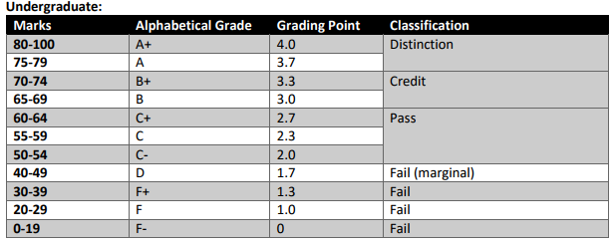
Achievement requirements

Slide 20
Question and answer session
Q & A

Slide 21
What we will cover next
Basic Switch and Switching Concepts

